Slide 1
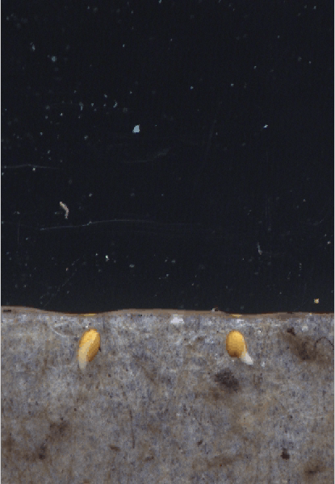
cry1
wild type

Slide 2
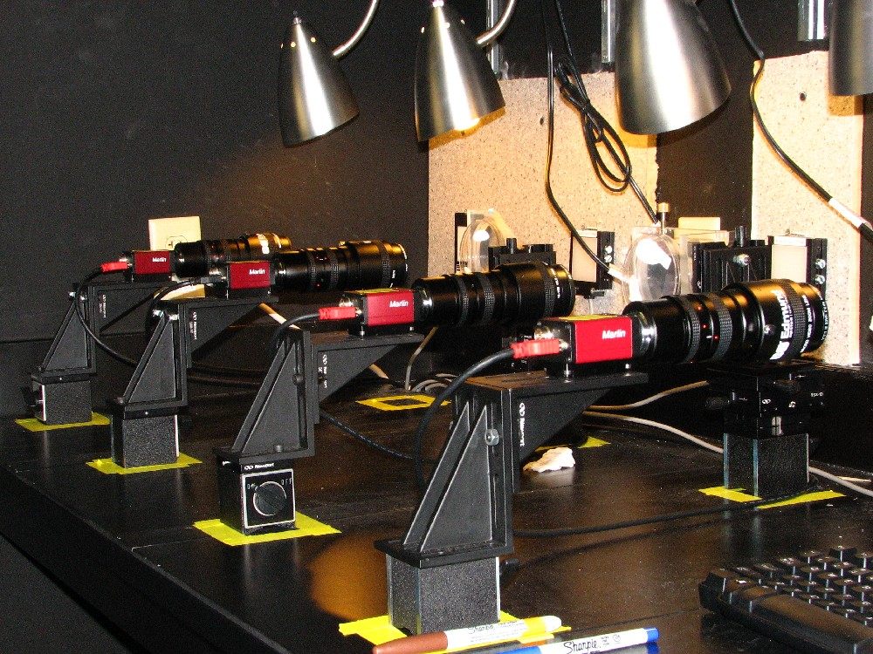
A multicamera image acquisition platform
In different rooms for different purposes we have approximately 20 of these CCD cameras equipped to image Arabidopsis or maize seedling development. http://phytomorph.wisc.edu/hardware/fixed-cameras.php

Slide 3
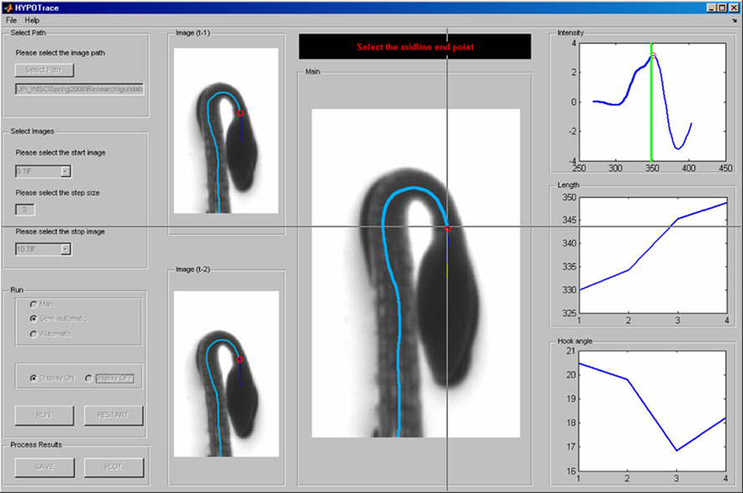
Screen shot of the HYPOTrace program
(software that automates some seedling measurements)
download at http://phytomorph.wisc.edu

Slide 4
Example HYPOTrace Results
(the basis of the height difference is revealed)
WT cry1
cry1
wt
Time (h)
Machine vision studies of obvious phenotypes provides detail about the missing gene’s function.

Slide 5
Automation Changes the Game
Automation does more than remove tedium.
It enables more variables to be explored.
This produces a richer description.
The data can support computational analysis.
Together these things may change the way you think about phenotypes.
Automation allows more dimensions to be explored. A description in three dimensions can be much more useful than a two-dimensional description. For example…

Slide 6
My mutant has no phenotype! #!*@!!^&#!

Slide 7
Does my mutant have a phenotype?

Slide 8
My mutant has a phenotype!

Slide 9

And if you are lucky….
My mutant has a BIG phenotype!

Slide 10
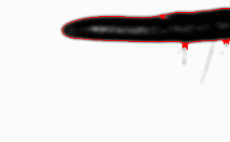
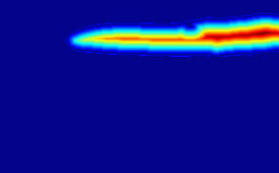
Root gravitropism is our first high-throughput test case
Image processing algorithms find the midline of the root in each frame
implemented by Nathan Miller

Slide 11
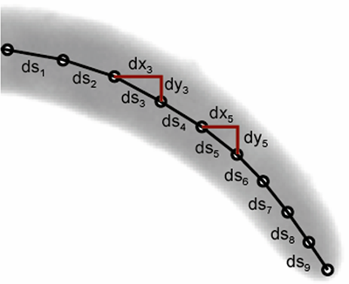
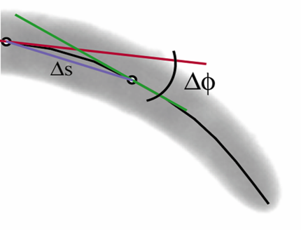
Parameters such as length and local curvature and their time derivatives are extracted from the midlines, or medial axis
length
local curvature, K = ΔΦ/Δs
implemented by Nathan Miller

Slide 12
We measured the responses to gravity of a lot of roots across a grid of conditions
Growth rates &
tip angles
extracted
from >645,000
images of
>2000 roots
Notes:
12

Slide 13
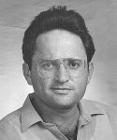
Then we met Miron Livny
Miron Livny
“you need a workflow, and you need Condor”

Slide 14
Here is a workflow we created that uses Condor and the CHTC grid
File upload
(data, such as time series of images)
Selection of algorithm to apply
Check status of analysis
Receive results as csv file
Server (Baracuda) hosting PostgreSQL database
Input file is matched with appropriate algorithm and processed on a Condor grid
PostgreSQL database modeled to accommodate tip angle and growth rate
Let’s try it

Slide 15
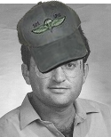

Captain Condor
“Make me the bottleneck – I dare you!”

Slide 16
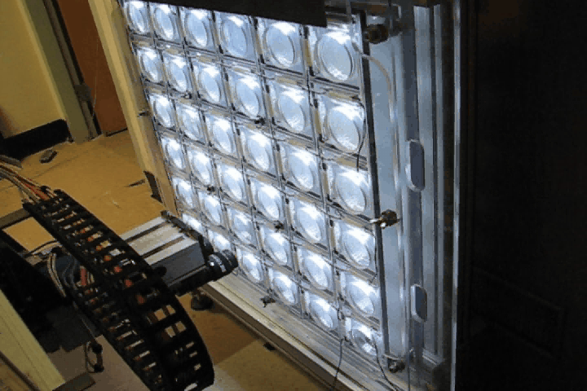
Robotics is increasing our data acquisition throughput, hopefully making the computation once again the bottleneck

Slide 17
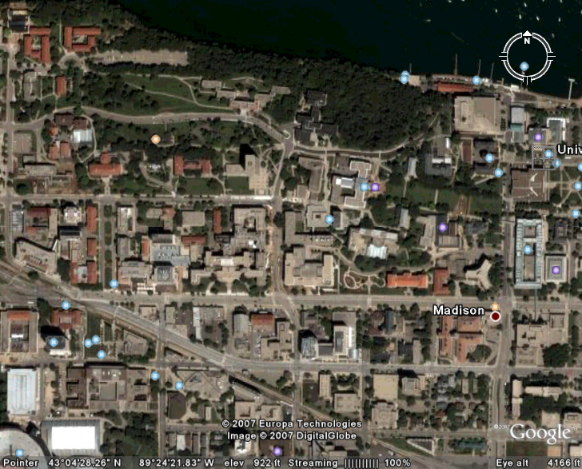
Geographically, the distance between Botany and CS is small, but building a functional bridge between them is easier said then done. Happily, the payoff has been large.
Botany
Computer
Sciences

